Slide 1
Fracture Risk in Missouri
Ana Bjelica | 2026
Abstract
Fracture risk due to low bone density affects over 40 million Americans, with about 50% of women and 20% of men experiencing an osteoporosis-related fracture in their lifetime. Risk is higher in populations with older age, lower income, lower educational levels, and limited healthcare access.
This project uses Missouri county-level data to examine how biological, socioeconomic, and healthcare access factors contribute to fracture risk. Twelve variables were grouped into three domains, standardized using z-score normalization, and aggregated to create a composite relative risk score (termed “Unmet Risk Index”, or URI). Finally, the counties were clustered into three groups based on risk levels.
The goal of this project is to bring awareness to fracture risk and the need for earlier identification of at-risk populations, as well as to encourage understanding of geographical public health disparities.

Slide 2
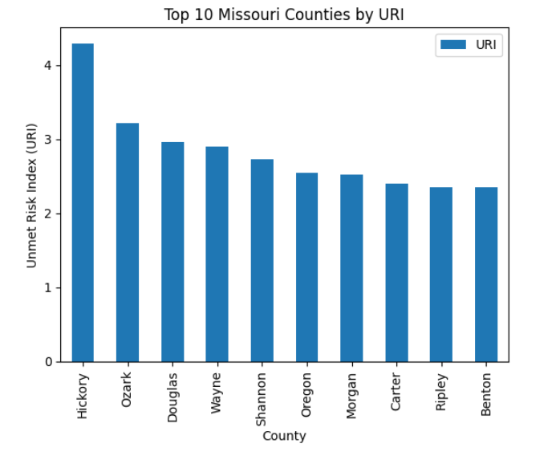
Figure 1 | Top 10 counties in Missouri with the greatest unmet fracture risk, based on URI (Unmet Fracture Risk) scoring.

Slide 3
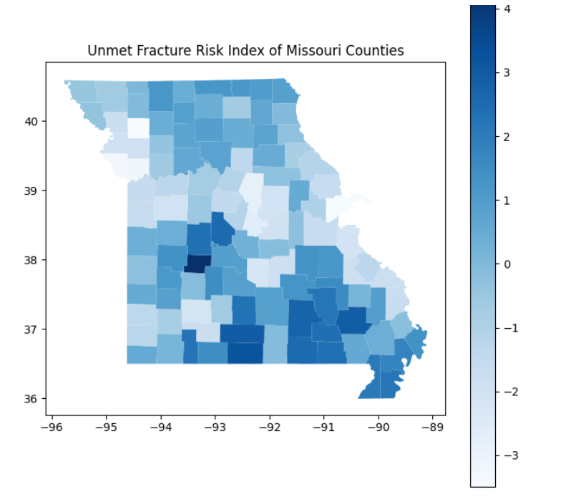
Figure 2 | Darker colors indicate highers URI scores. Areas with higher fracture risk appear to be west-central and south-central Missouri.

